Slide 1
Introduction To ROS 2
Yunus Akdal
Burak Güler

Slide 2
What is ROS 2?
ROS2 is an open source software development kit
Provides useful robotic tools, libraries and capabilities therefore minimizes the time lost for development of robotic applications
The primary purpose of ROS2 is to facilitate data sharing over NODES.
Its modular structure allows for layered development and code scalability.

Slide 3
What is NODE?
ROS 2 nodes are the fundamental building blocks of a ROS 2 system. A node is a process that performs computation and communicates with other nodes in a distributed system.
This Nodes provide us to develop modular softwares.

Slide 4
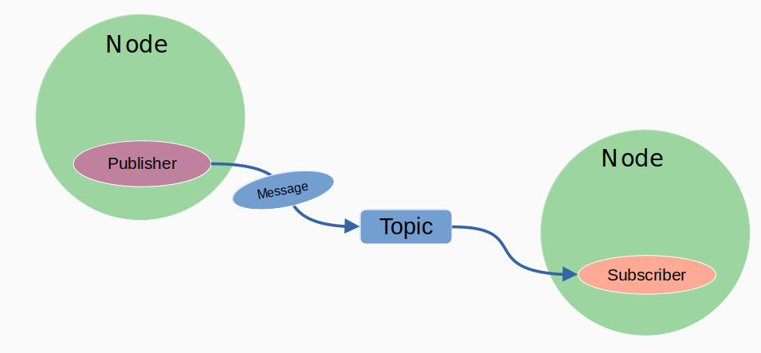
Main Concepts in Nodes
Publisher
Subscriber
Message
Topic

Slide 5
One Node can have a multiple subscriber and multiple publisher.
One topic should have one message type.

Slide 6
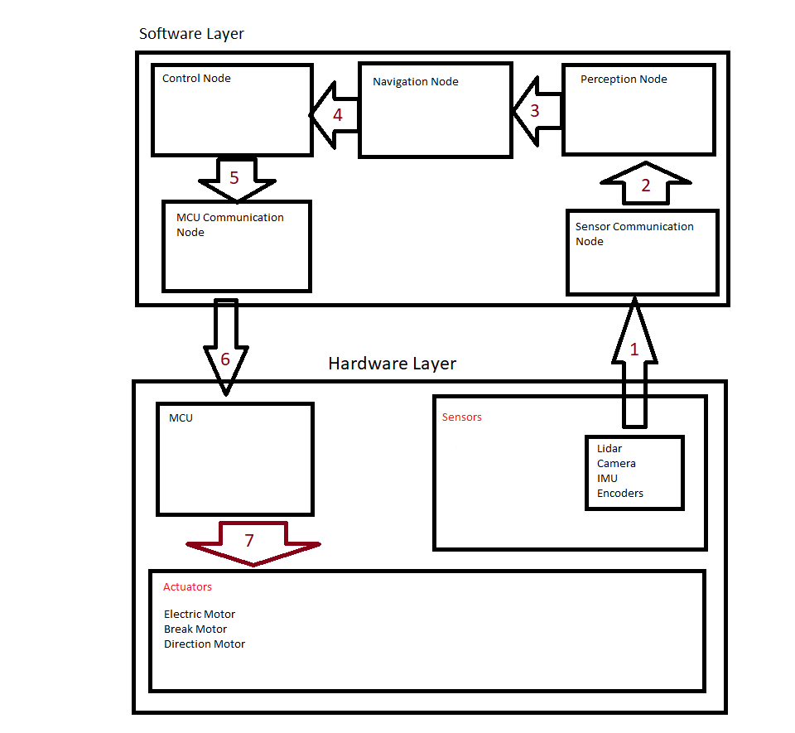
Example Of Node Schema
Sensor Publishing via ethernet, rs232, serial etc.
Sensor Communication Node collects all data and publish in Ros Topics.
Perception Node Takes Lidar scans and Camera and Perceive environment and publish Obstacles map to Navigation Node with Ros Topics.
Navigation Node create path and publish path with Ros Topics.
Control Node Creates Command that will track path and publish the commands to MCU Communication Node with Ros Topics.
Communication Node publish Commands to MCU that will drive Actuators via ethernet, rs232, serial etc.
MCU apply the Control Commands to actuators.

